Slide 1
Noncompliance and Reporting/FOIA
Rob Anderson,
Becky Armstrong,
Amy Chuang,
Randy Nelson,
Sally Thompson-Iritani
B

Slide 2
Goals:
To understand noncompliance in relation to animal welfare concerns.
To determine reportability and the impact on animal welfare and science.
B

Slide 3
Objectives:
The learner should be able to:
  Recognize potential noncompliance in animal care and use programs;
  Describe the steps for communicating and verifying concerns;
  Categorize compliant vs. noncompliant incidents;
  Evaluate whether a noncompliance is reportable and to whom;
  Explore implications of reporting noncompliances.

Slide 4
Expectations
During this session we are going to have you conduct structured and free form activities designed to achieve the objectives that we have just listed.
In order to maximize your ability to gain information from these sessions, your active participation will be required.
These sessions rely upon knowledge gained in the materials provided to you ahead of time.
Divide into groups.
S

Slide 5
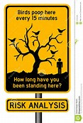
Participant Activity #1:
In your assigned group, brainstorm a list of potential noncompliances (10 minutes).
Write each potential noncompliance on an individual post-it note.
Classify on potential risk and bring to the front of room.
A
Notes:
Should be 2 options:
Condensed: Group should develop a list of potential noncompliances in 2 minutes. Share ideas – post paper with low risk and high risk at the top of the easel page.
Extended: With more time - may be able to divide into groups more reasonably. For future should allot at least 10 minutes to brainstorm the noncompliances. Add slide that shows high/low risk.
Guided concensogram instruction - go to the board and demonstrate what it will look like.
Give Examples: low risk: Caretaker was late to feed animals by 4 hours. High risk: pipe burst - 3 inches of water in cages -

Slide 6
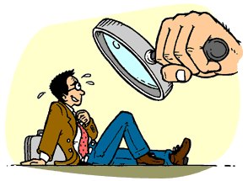
Activity #2: Investigation Role Play
Assume you are PHS funded, USDA species, AAALAC accredited.
3 low risk, 3 high risk – assign to tables
Fact Find: What do you know?
  What don’t you know?
  What do you need to know?
Divide each group in half (½ IACUC; ½ PI)
Notes:
Identify the most frequent high and low risk items from activity #1. You will need one item for each group you have (½ high risk, ½ low risk)
Assign half of your groups a high risk item and the other half a low risk items.
Instruct the groups to divide in half:
Half of each group will play the role of the IACUC and fact find: What do you know? What don’t you know? What do you need to know?
The other half of each group will play the role of the noncompliant researchers. They will be responsible for creating details regarding what the specific incident was, and how it occurred.
Allow about 5 minutes for discussion (adjust time based on engagement level of the group)
Have one person from each group give a 1 minute summary of the discussion.
Note: The product of this discussion will be used by each group as their scenario in activity #3

Slide 7
Participant Activity #3
Compliant/Noncompliant
Reportable/Nonreportable
Is it reportable to the IACUC
Is it reportable to regulatory/accrediting agencies
R
Notes:
When a module has more time then this could be a great opportunity to make this specific for an institution.
This can be customized for an individual unit when you are teaching the class.

Slide 8
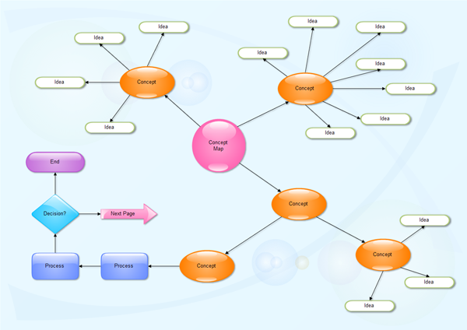
Participant Activity #4:
Impact of Reporting
R
Notes:
Need instructor notes – maybe do an example of what we see in the bubbles – FOIA, institutional risk, loss of reputation, funding, how does it get reported to the department and impacted individuals.
Facilitator Notes:
Need to set scenario of what the noncompliance is that needs reporting. (E.g. NHP, unapproved Sx, PI tends not to amend protocols, DoD & NIH funded, PI hired a new student (undercover activist) who was never added to protocol who subsequently released photos of unapproved Sx procedure to public, and IACUC wants to suspend protocol).
In my pilot test with staff they generated the main “bubbles” by categories of what they thought the issues were (Animal welfare, public relations, regulatory compliance, funding, reporting to agencies, IO, HR, Sponsored Projects Office, IACUC & protocol noncompliance).
Then in the next wave they identified other related aspects under each of the above main topics and “who” might be involved in doing these communications. Most likely this will end up being very institution specific. (E.g. Reporting – AAALAC, OLAW, USDA; Notifying funding agencies; moving animals to holding protocol; contacting UC Police; notifying other lab members; informing Dept. Heads/Deans).
Discussion of “who” centered around the IACUC members initially in making a decision re: suspension and then it fell to the IO, ACUC Chair, AV and Director of the Office of Animal Care and Use (OACU) along with the Media Relations folks to address the other concerns and issues and pull in others as needed like the UC Police) and those 4 individuals were involved in many of the bubbles with the IO being the ultimate person in terms of reporting and the Media folks dealing with the “public” aspects of this.
The impact of a report that could lead to a FOIA request, really wasn’t deemed by IACUC (OACU) staff as as big of a deal as finding and dealing with a really bad noncompliance situation.
What the group found interesting was how complex the concept map ended up being and how much cross-linkage there was between the bubbles.
How the facilitator sets up the exercise will impact the focus and also affect the level of detail you delve down into.

Slide 9
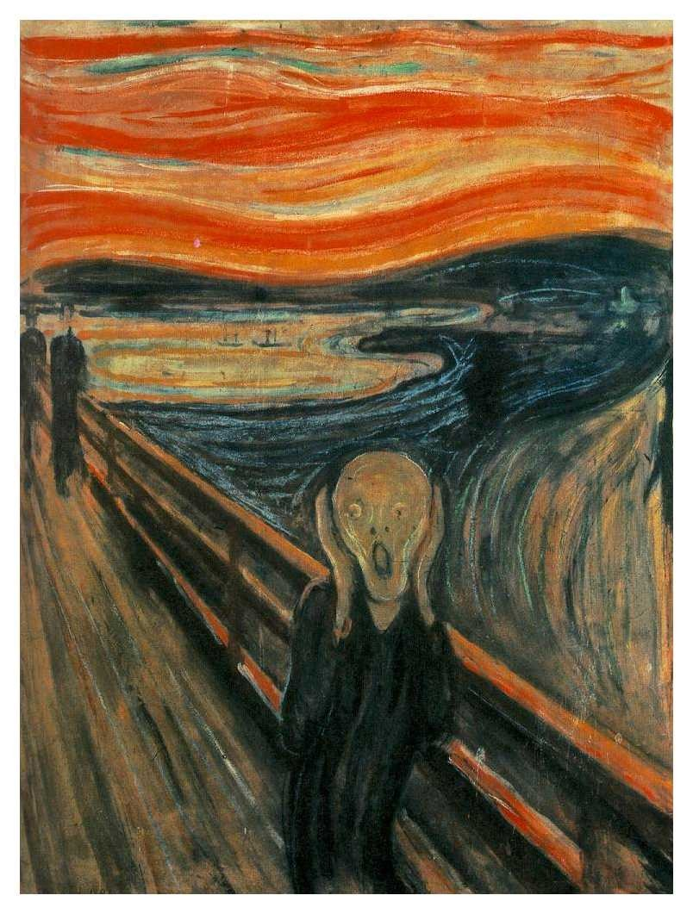
Exam Time
  Technician Tim goes to pick up his girlfriend in the Smith laboratory at 6:00 pm one Friday evening. He walks by Dr. Smith’s laboratory and notices animals in a cage on the bench. No one is around. Tim is concerned because he hasn’t seen animals there before.
  What should Tim do?
N
Notes:
This is the beginning slide of a multi-part scenario designed to be used with the decision tree included in this presentation. There are several parts to the scenario, each corresponding to levels in the decision tree. The audience should, at each level, determine the severity of the impact on animal welfare, if noncompliant event has occurred, and if so, if it is reportable and to whom. This first level explores fact-finding.

Slide 10
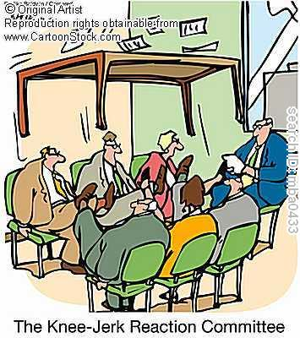
  Tim calls the compliance hotline. The call mobilizes the triage team. The team investigates and finds: 3 gerbils in a cage with no food or water. The cage card identifies Smith’s protocol number and contact information for his post-doc, Dr. Jones. The team cannot reach the PI or the post-doc because they are at an animal welfare workshop.
  What should the team do?
Notes:
This second level of the scenario mobilizes a team of experts to assess the severity of the event and what should be done about it. There may be need for intervention, both immediate and long-term, and for verification of assertions.

Slide 11

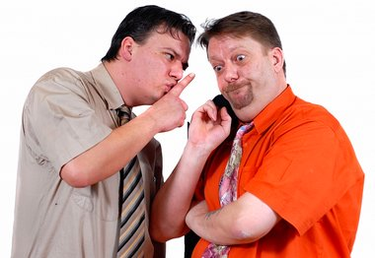
  The triage team contacts veterinary staff and gets animals housed in vivarium with food and water and contacts the IACUC chair person.
  The team remembers the protocol and there is no approval for food or fluid regulation or housing outside of the vivarium.
  What should the IACUC do?
Notes:
This third level describes the intervention upon which the triage team decided and the passing of information to the IACUC, acting as the the ethical review committee.

Slide 12


  As soon as possible the IACUC meets to consider the concern.
  Is this a noncompliant activity?
  To whom should it be reported?
  What may be the impact of reporting?
Notes:
The fourth level of the scenario allows the audience to decide, based on the facts presented, if there has been noncompliance, whether it should be reported internally or externally, and what the impact on the animals the research, and the institution’s reputation might be as a consequence of reporting.

Slide 13
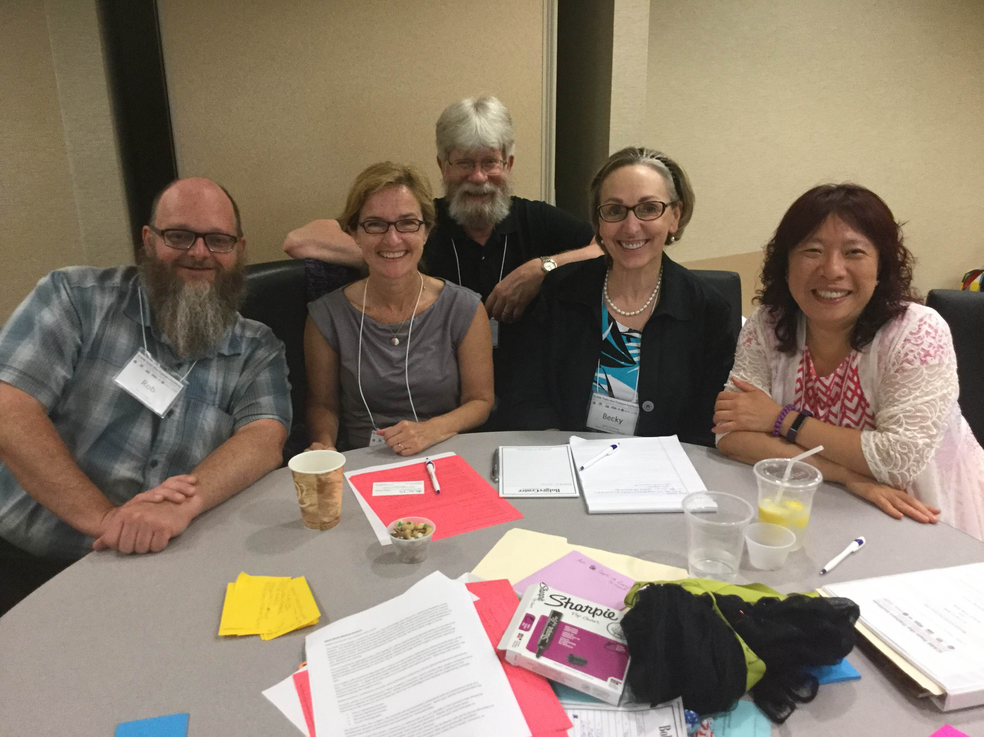
Epilogue
  While drafting the letter the IACUC administrator carefully reads the protocol and notices a recently approved amendment that includes approval for all of the items that are of concern.
Scenario brought to you by
Rob Anderson
Sally Thompson-Iritani
Becky Armstrong
Amy Chuang
Randy Nelson
“Category E” of ICare Train the Trainer’s Institute. Sponsored by NSF, NIH, USDA, FDA, VA, and PRIM&R.
Notes:
This final twist in the scenario illustrates that communication and fact verification are crucial to a position outcome.

Slide 14


